Slide 1
ESG Dashboard Project
Analyzing Global Sustainability Indicators (2020)
By: Ravindra Sahu ( Business Analyst Intern at Unified Mentor )
Tools: Excel, Power BI
Source: World Bank ESG Dataset

Slide 2
Objectives , Dataset & Tools Used
Objectives :
Build an interactive dashboard using Tableau or Power BI
- Visualize ESG indicators across countries
- Filter data by category and indicator
Enable performance comparison through maps and charts
Deliver clear insights into global sustainability efforts
Dataset Overview :
- Source: World Bank ESG Draft Dataset
Focus Year: 2020 (most complete and uniform)
Fields Used: Country, ESG Category, Indicator, ESG Value, Year, Performance Band
Tools Used : Microsoft Excel (for Data cleaning), Power BI (for Dashboard creation)

Slide 3
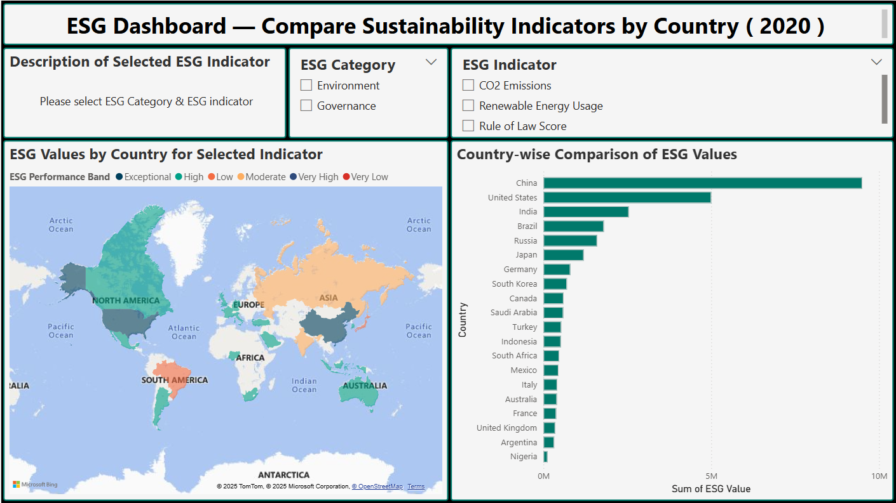
Slicer to Filter by Category
Dashboard Overview
Description Panel
Slicer to Filter by Indicator
Map - ESG performance by country
Bar Chart - Compare ESG values across countries
2

Slide 4
Key Insights
China and USA lead in ESG Value for selected indicators, especially environmental ones like CO₂ emissions and energy use.
Countries like Nigeria, Argentina, and South Africa fall under lower performance bands, indicating development gaps in sustainability.
Governance-related indicators show tighter ESG Value ranges across countries compared to Environment-based metrics.
Most values concentrate between Medium to High bands, with very few in Exceptional or Critical categories.
Slicer filters and Description panel enhance usability, allowing deep exploration of Individual indicators.
3

Slide 5
Conclusion & Learning
Final Outcome :
- Created a fully interactive ESG dashboard aligned with project objectives
- Visualized ESG indicators across 20 countries using maps, charts, and filters
- Enabled users to filter by category, year, and indicator
Key Learnings:
- Working with real-world ESG data and resolving formatting issues
- Designing user-friendly dashboards with meaningful insights
- Building value bands and using color coding for better comprehension
4

Slide 6
Thank You
Questions or Feedback Welcome

